Slide 1
2021

Slide 2
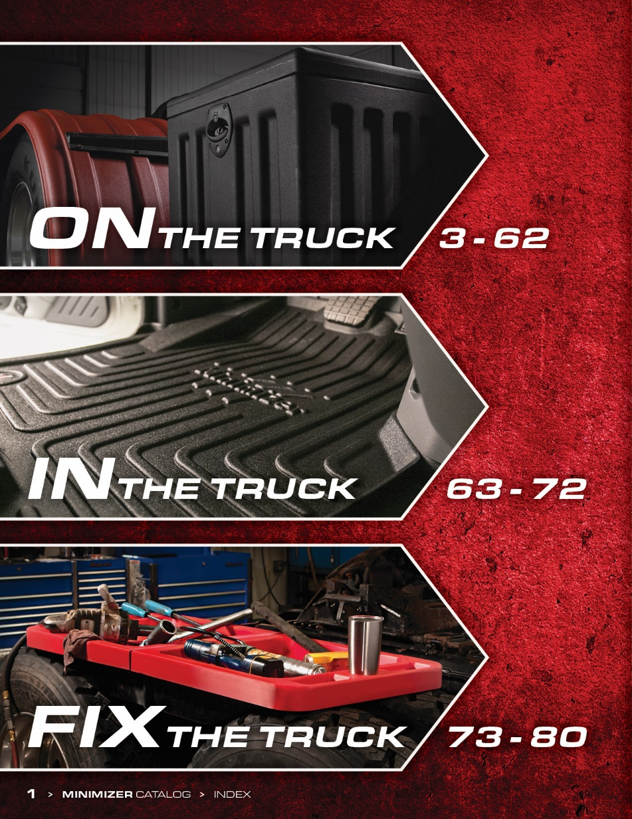
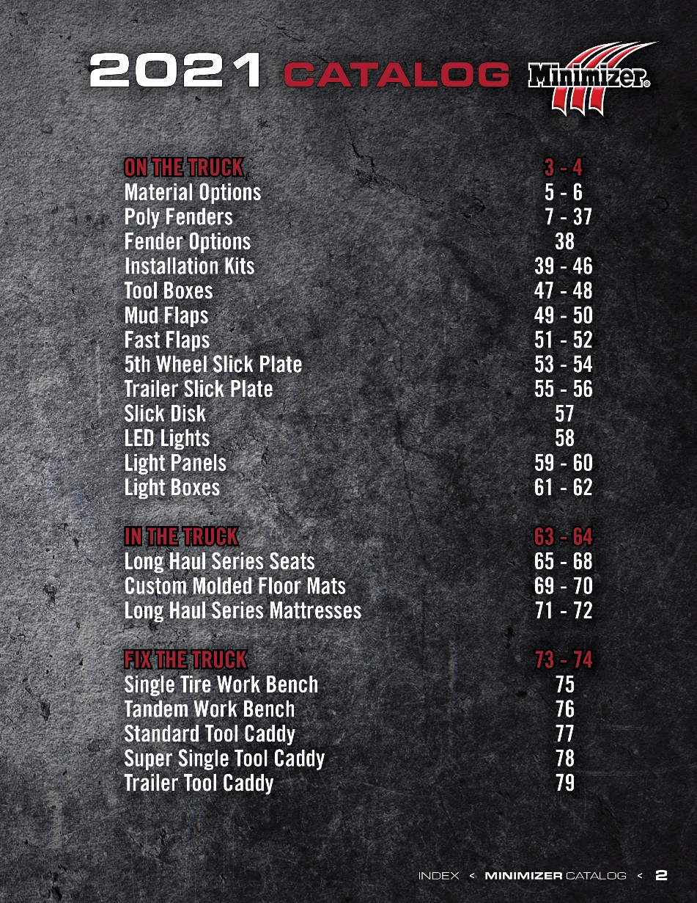
2021

Slide 3
2021

Slide 4
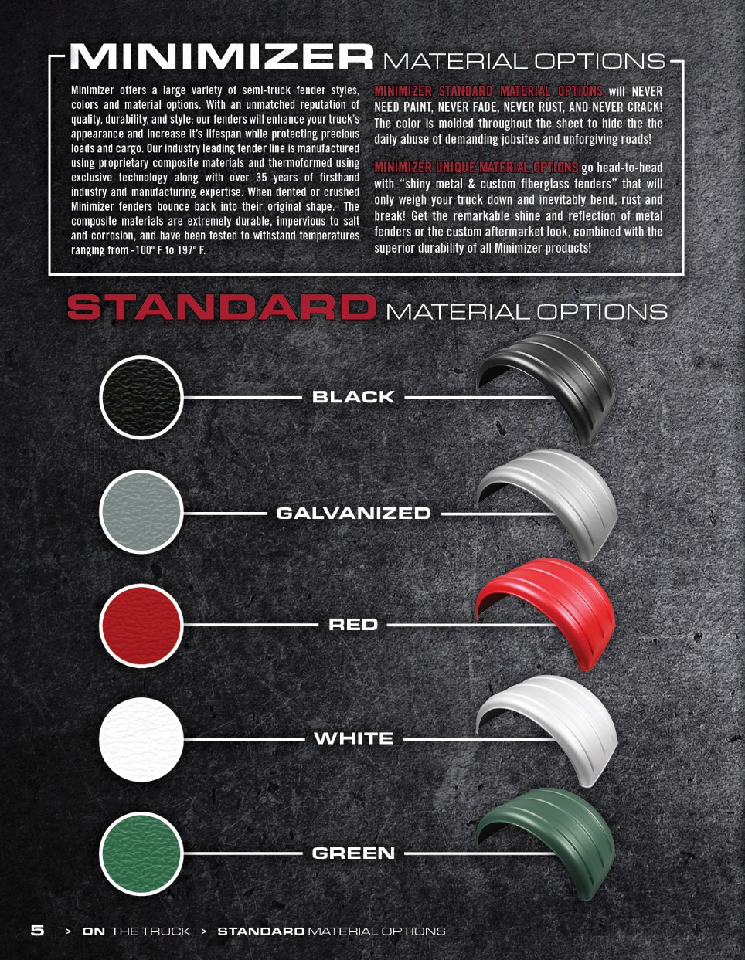
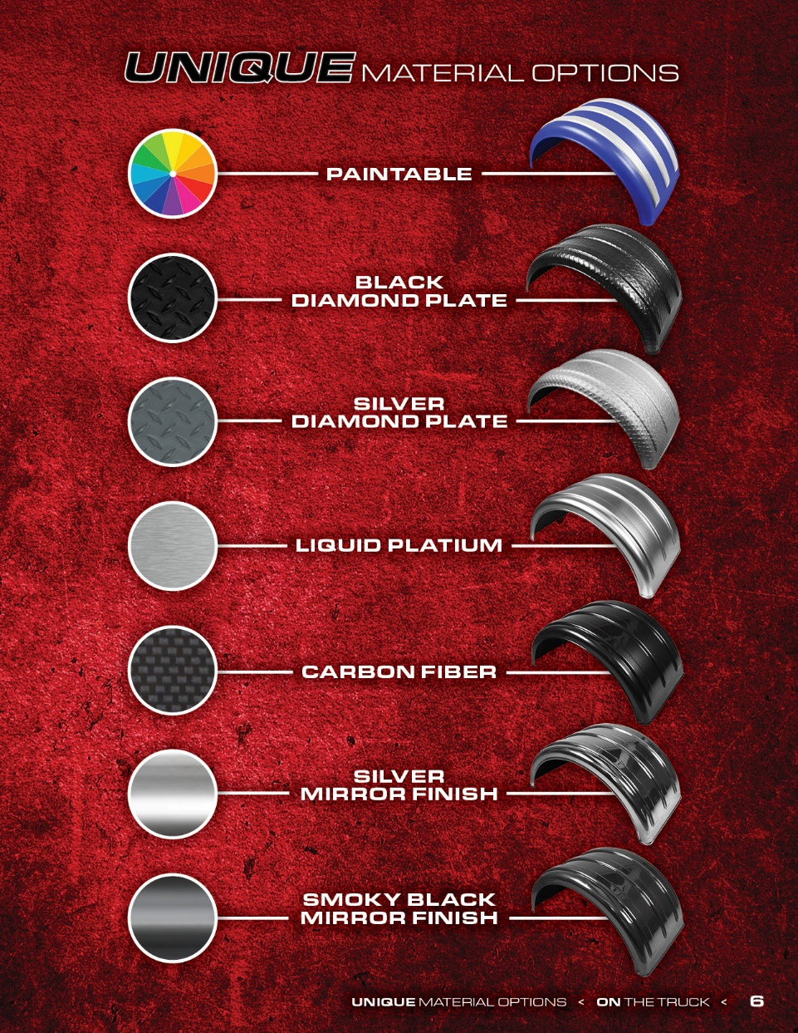
2021

Slide 5
2021

Slide 6
2021

Slide 7
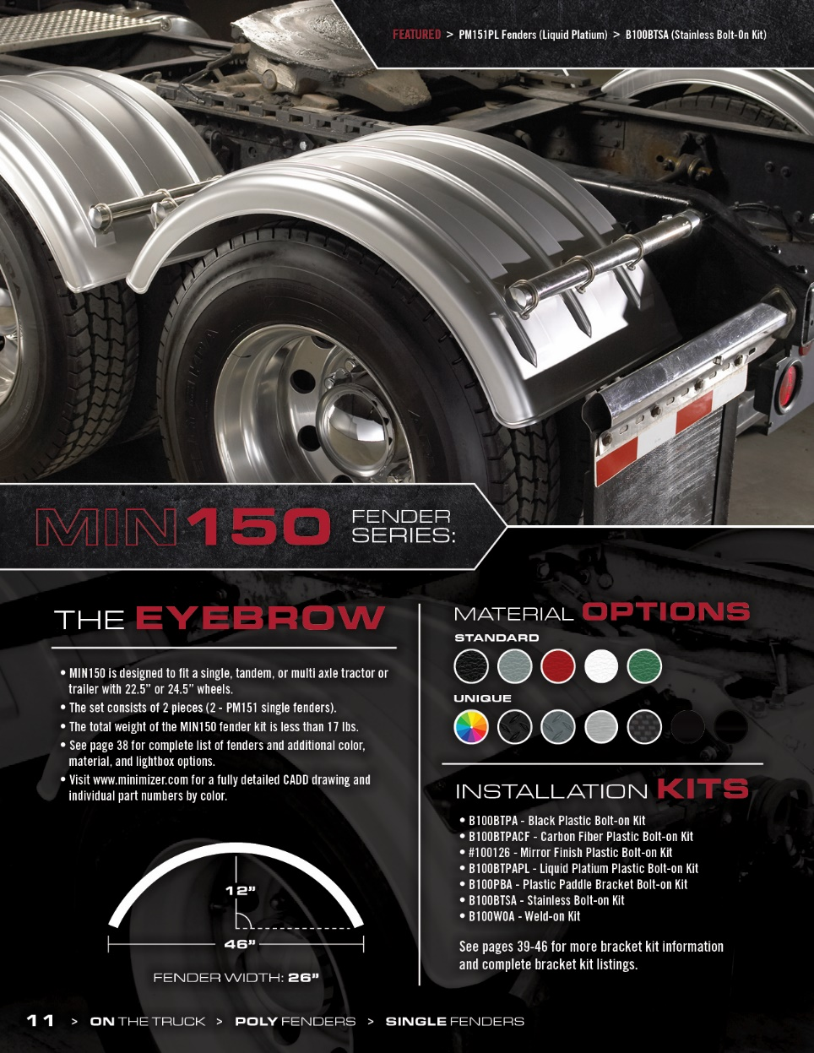
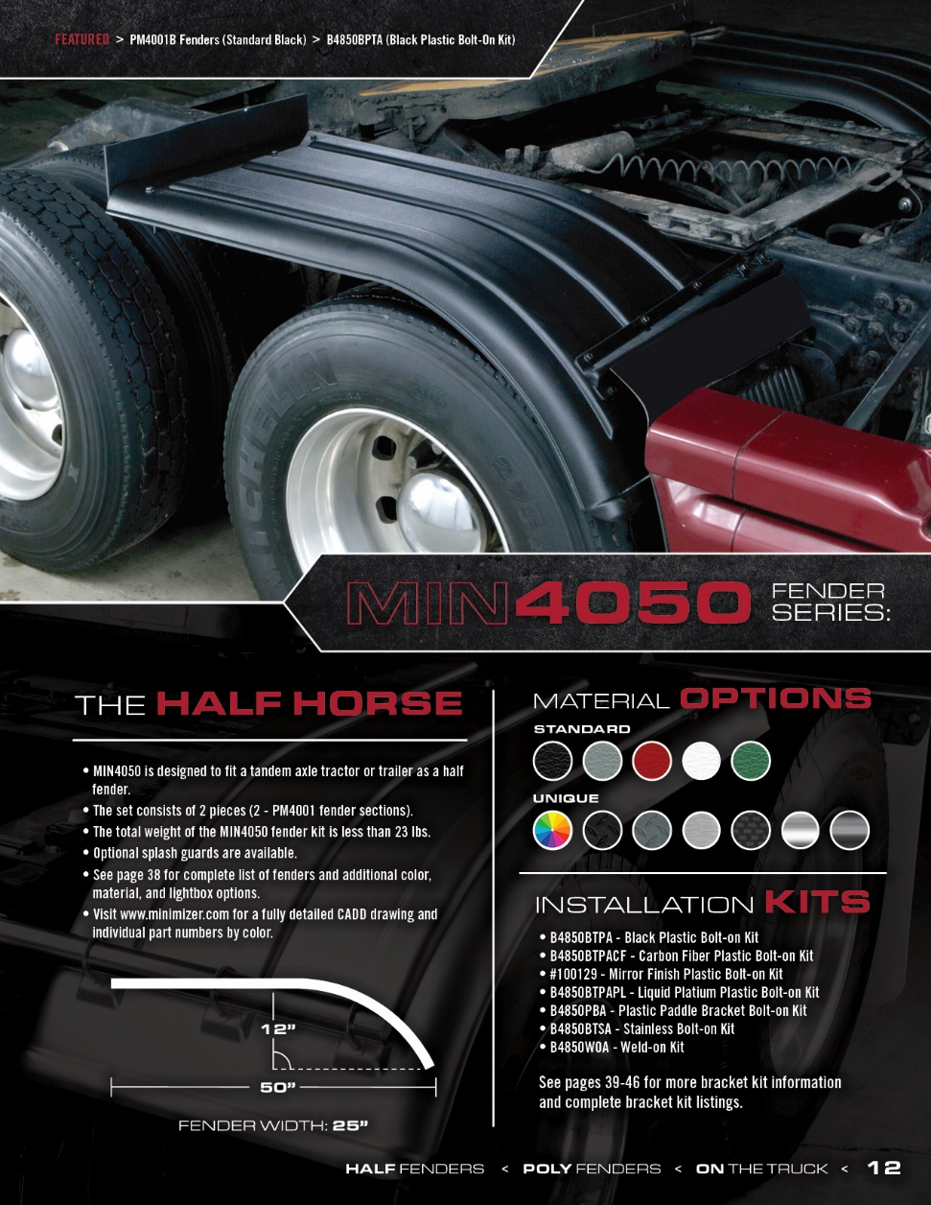
2021

Slide 8
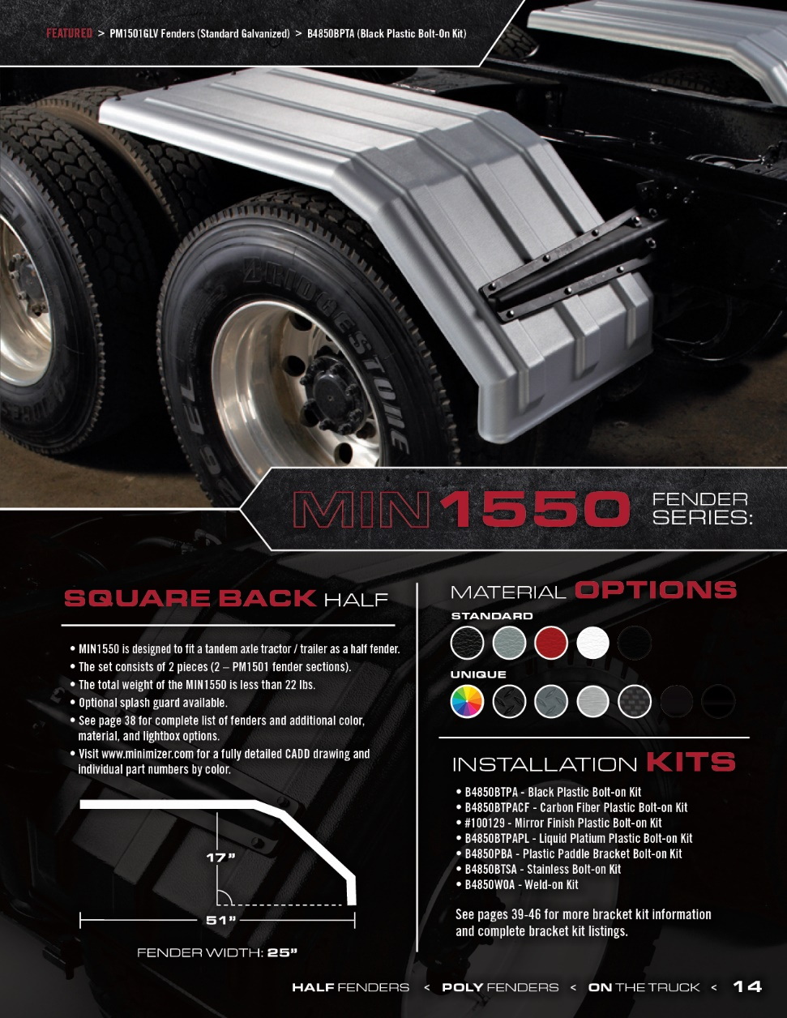
2021

Slide 9
2021

Slide 10
2021

Slide 11
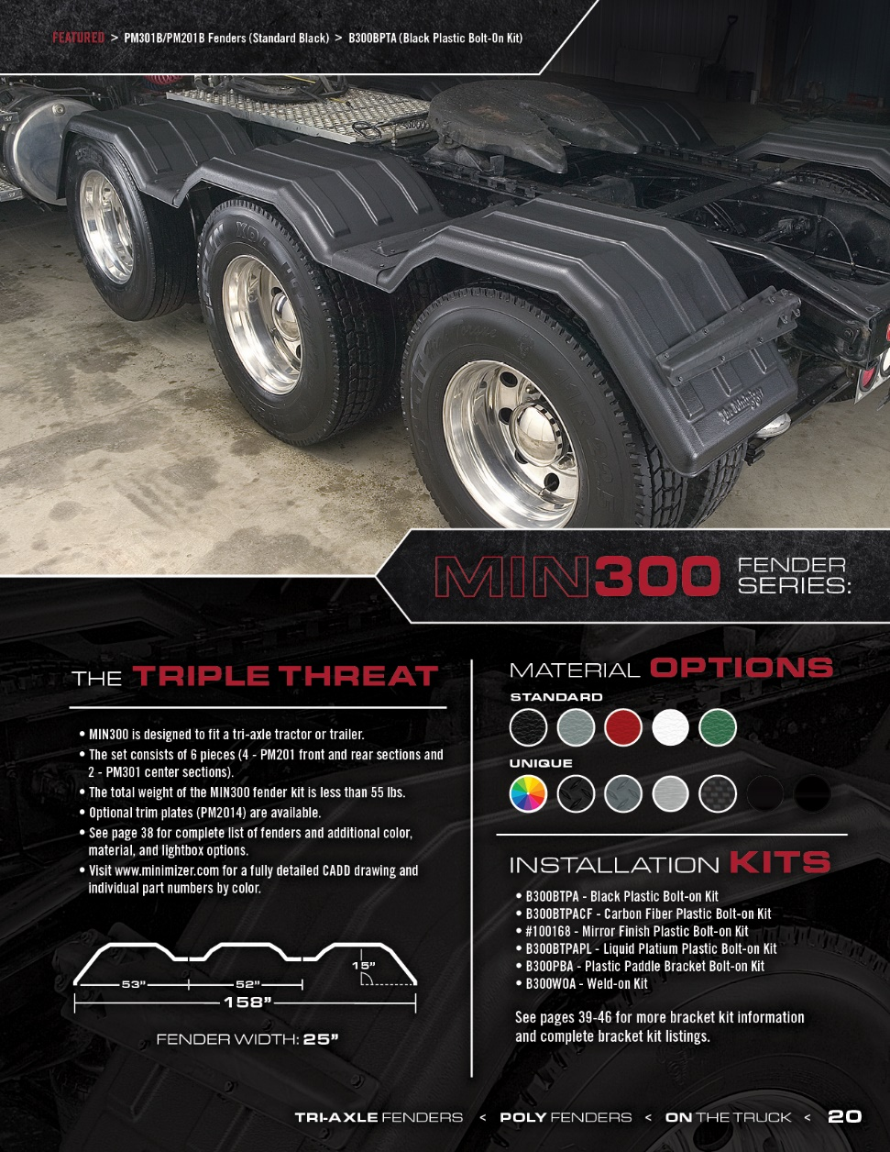
2021

Slide 12
2021

Slide 13
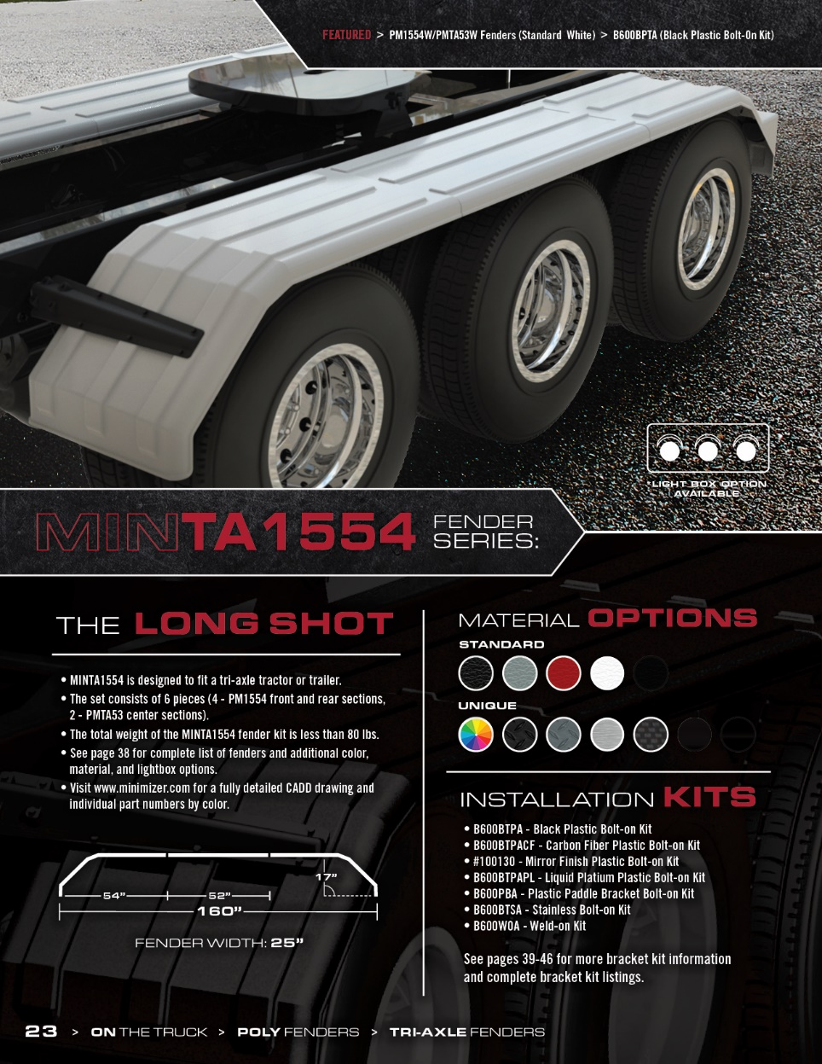
2021

Slide 14
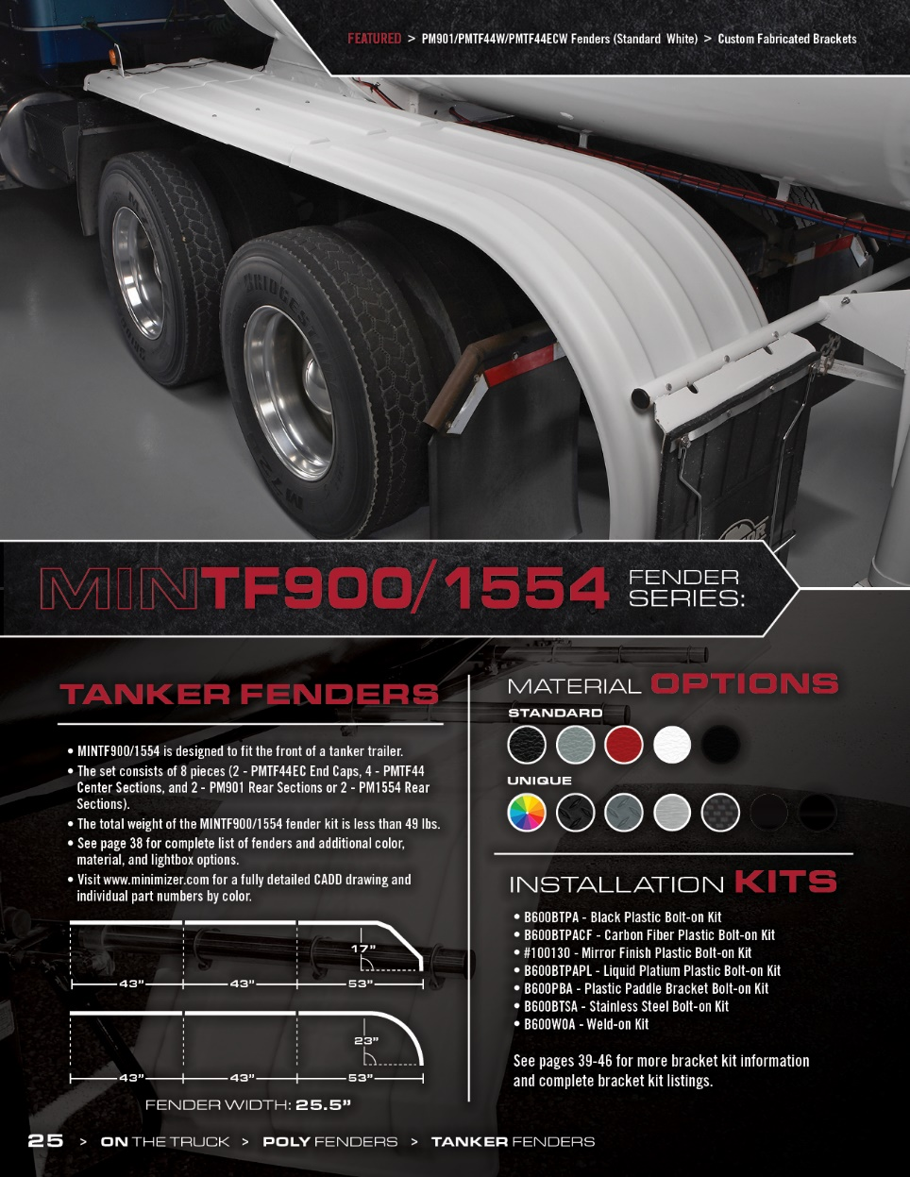
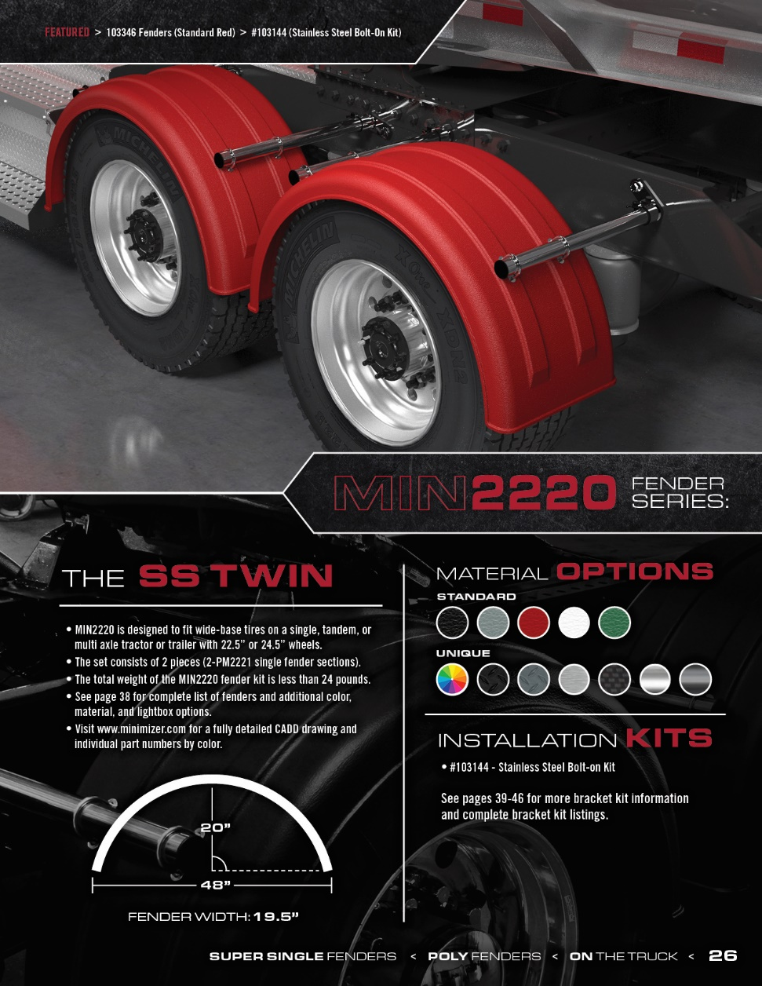
2021

Slide 15
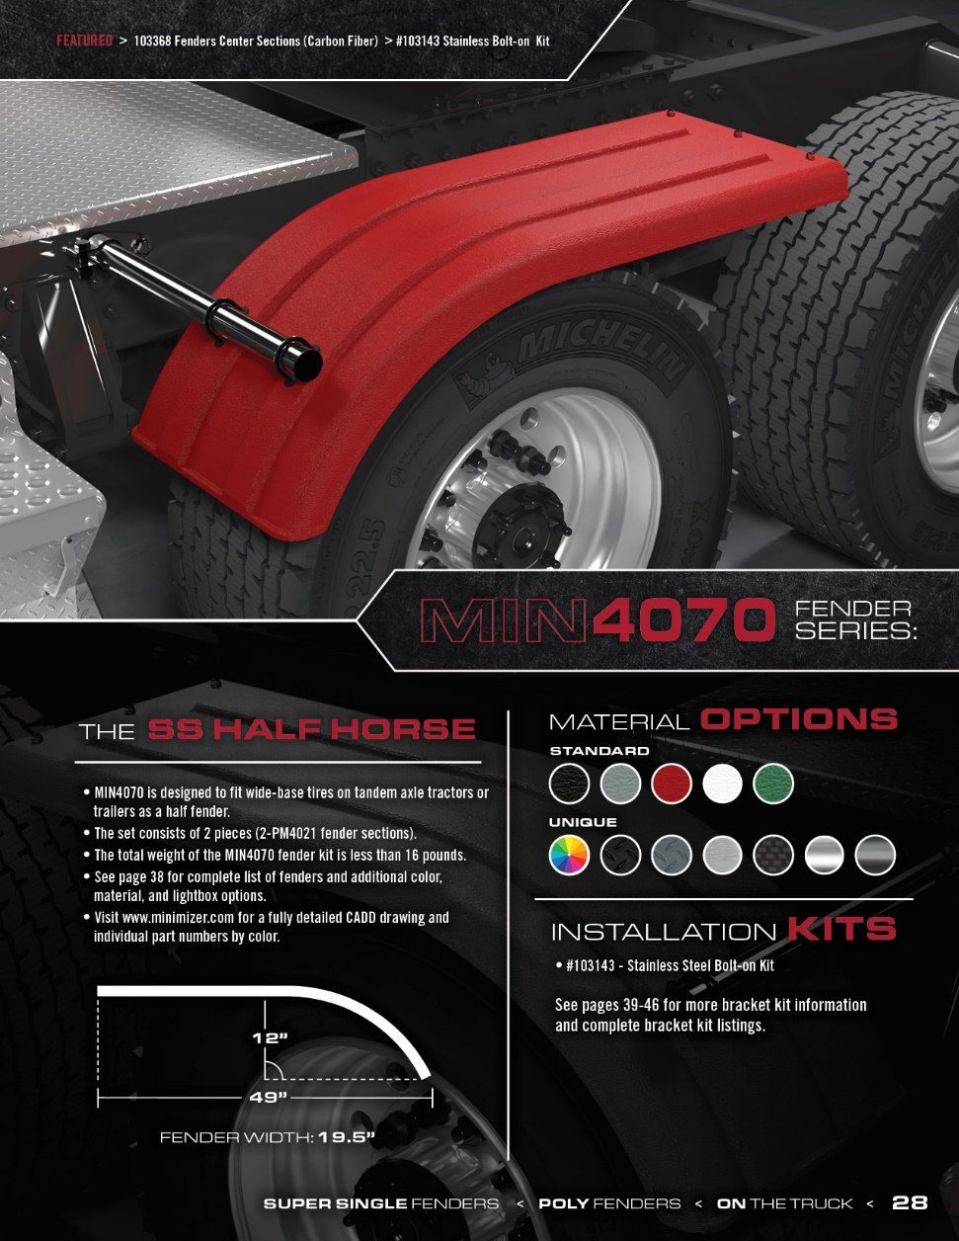
2021

Slide 16
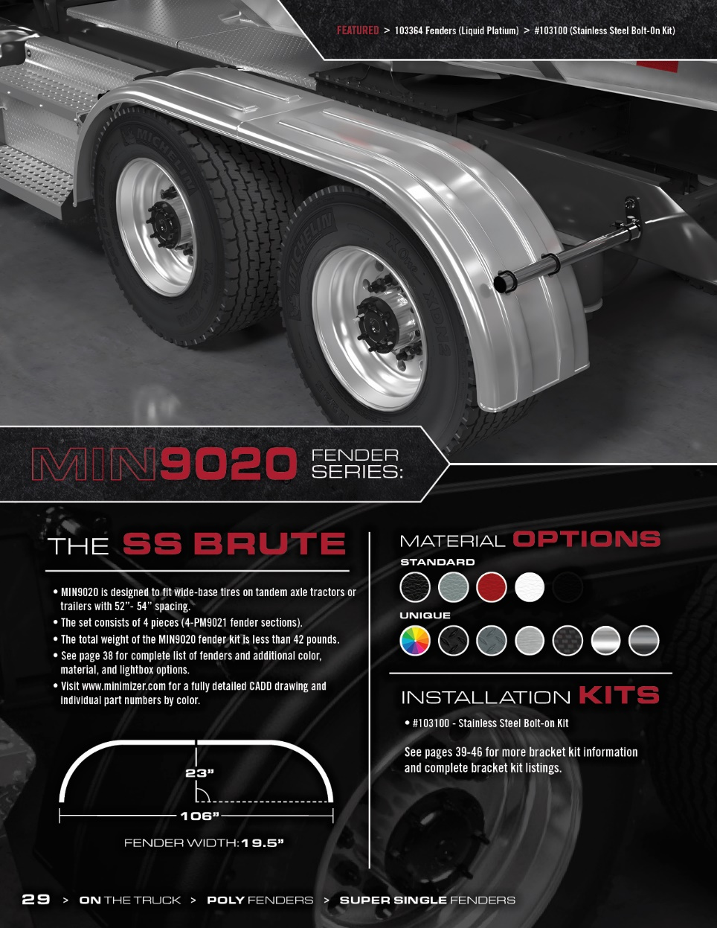
2021

Slide 17
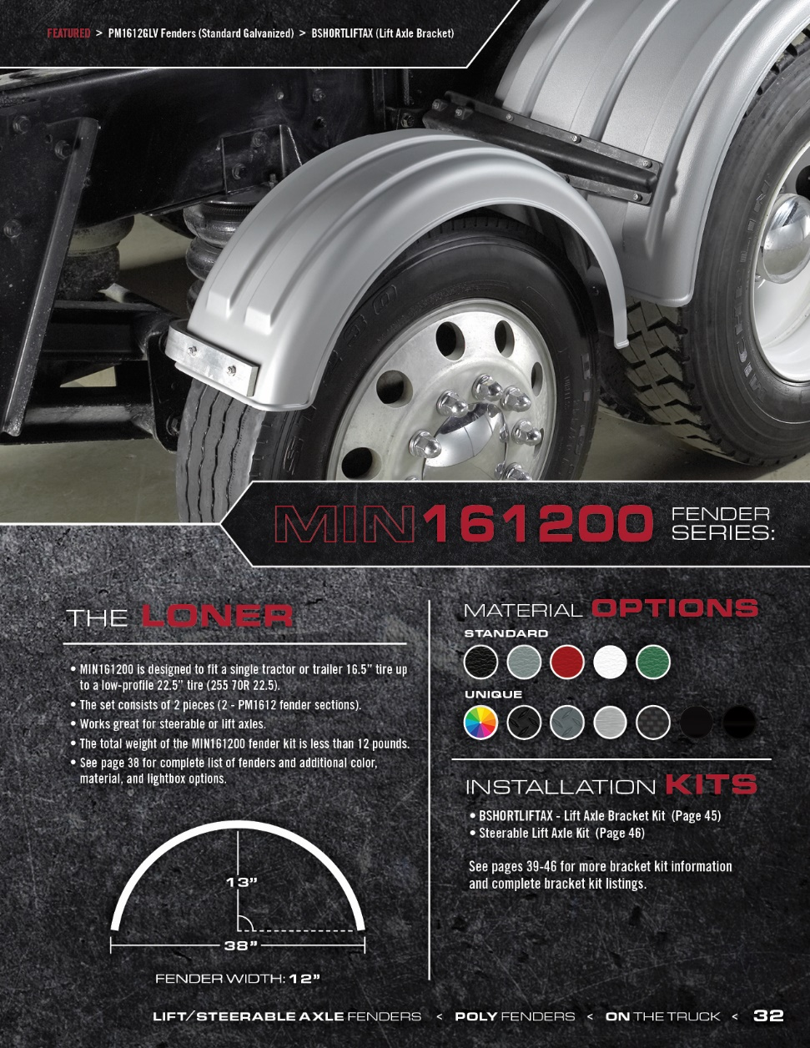
2021

Slide 18
2021

Slide 19
2021

Slide 20
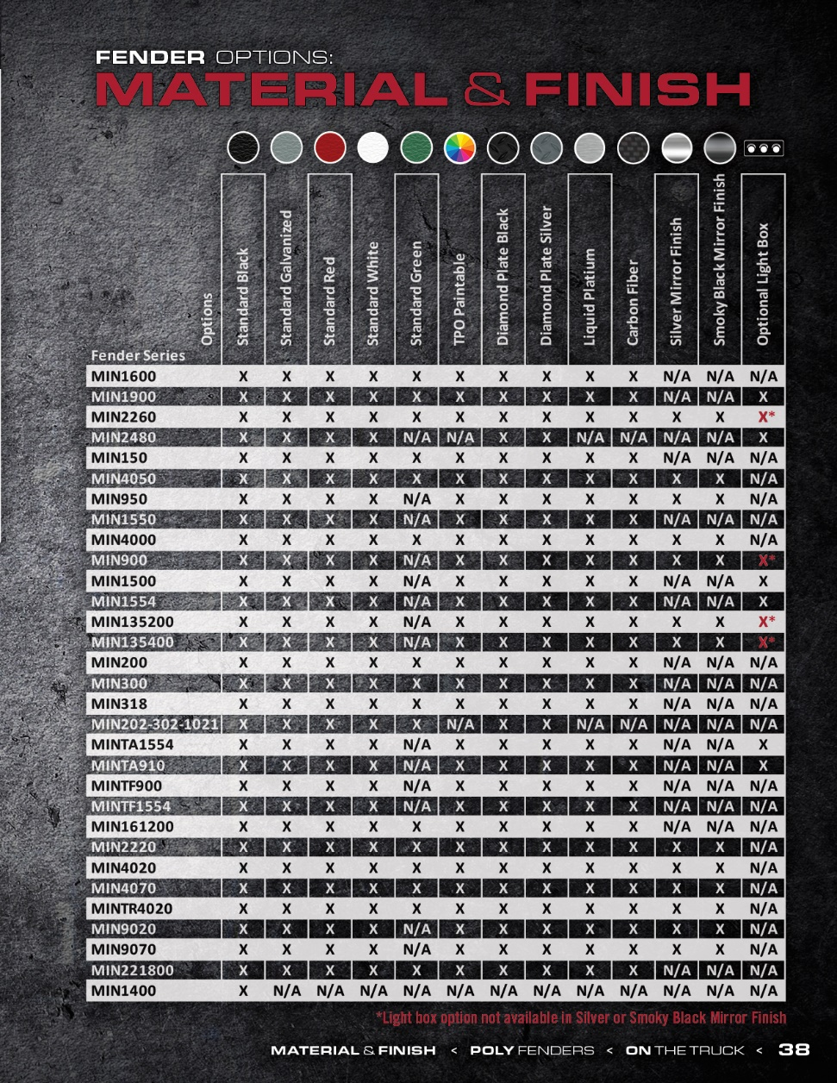
2021

Slide 21
2021

Slide 22
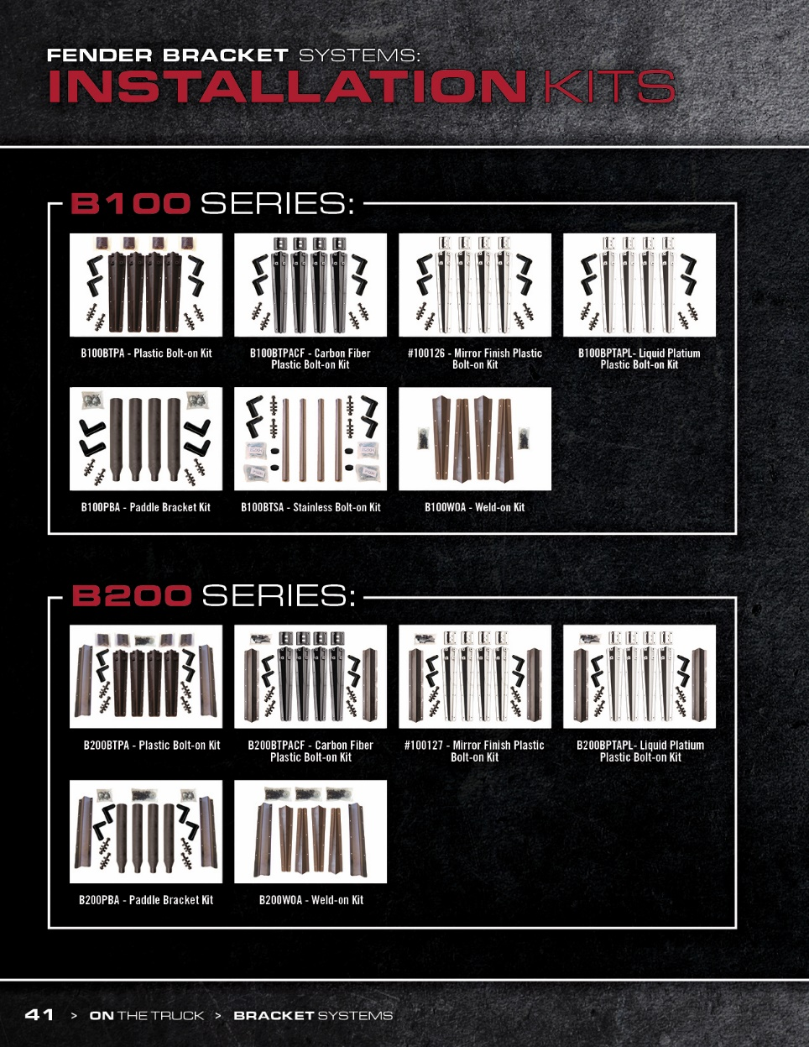
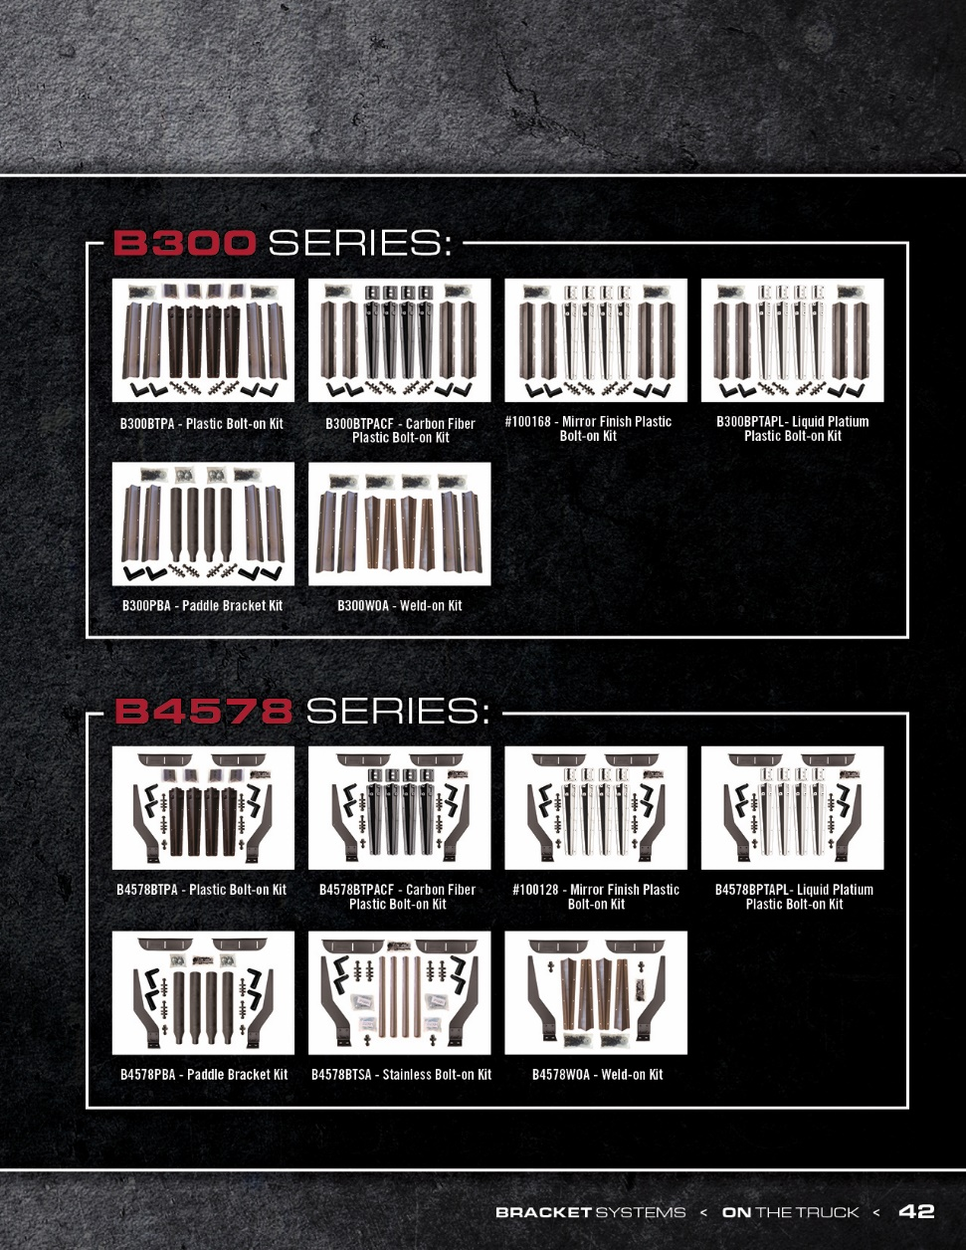
2021

Slide 23
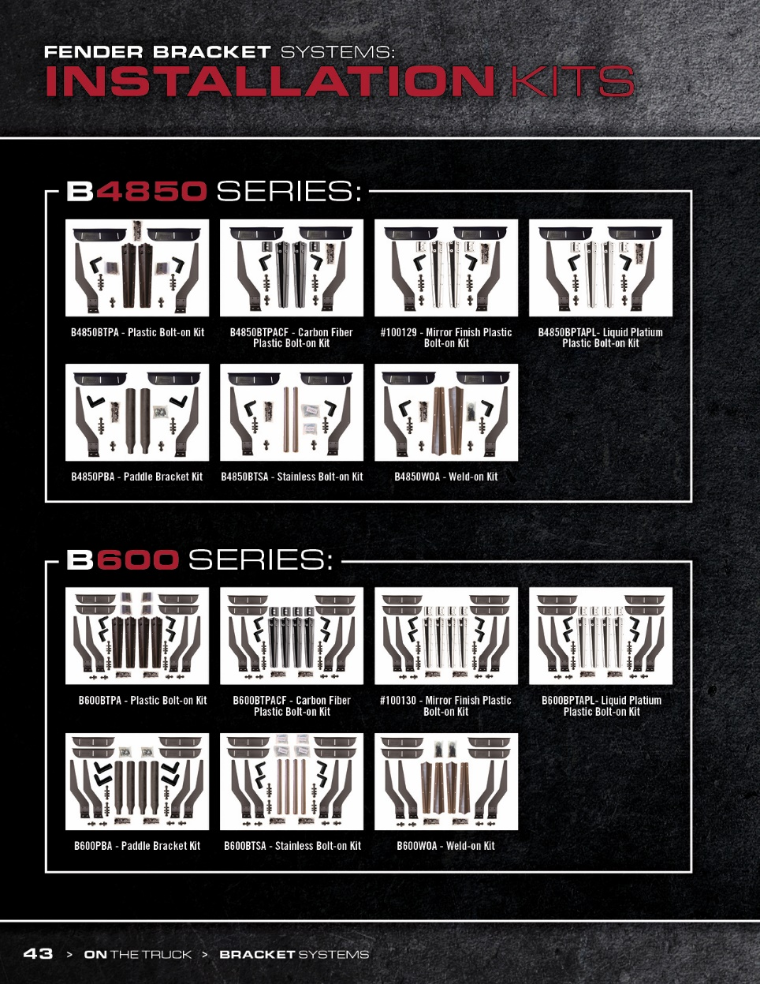
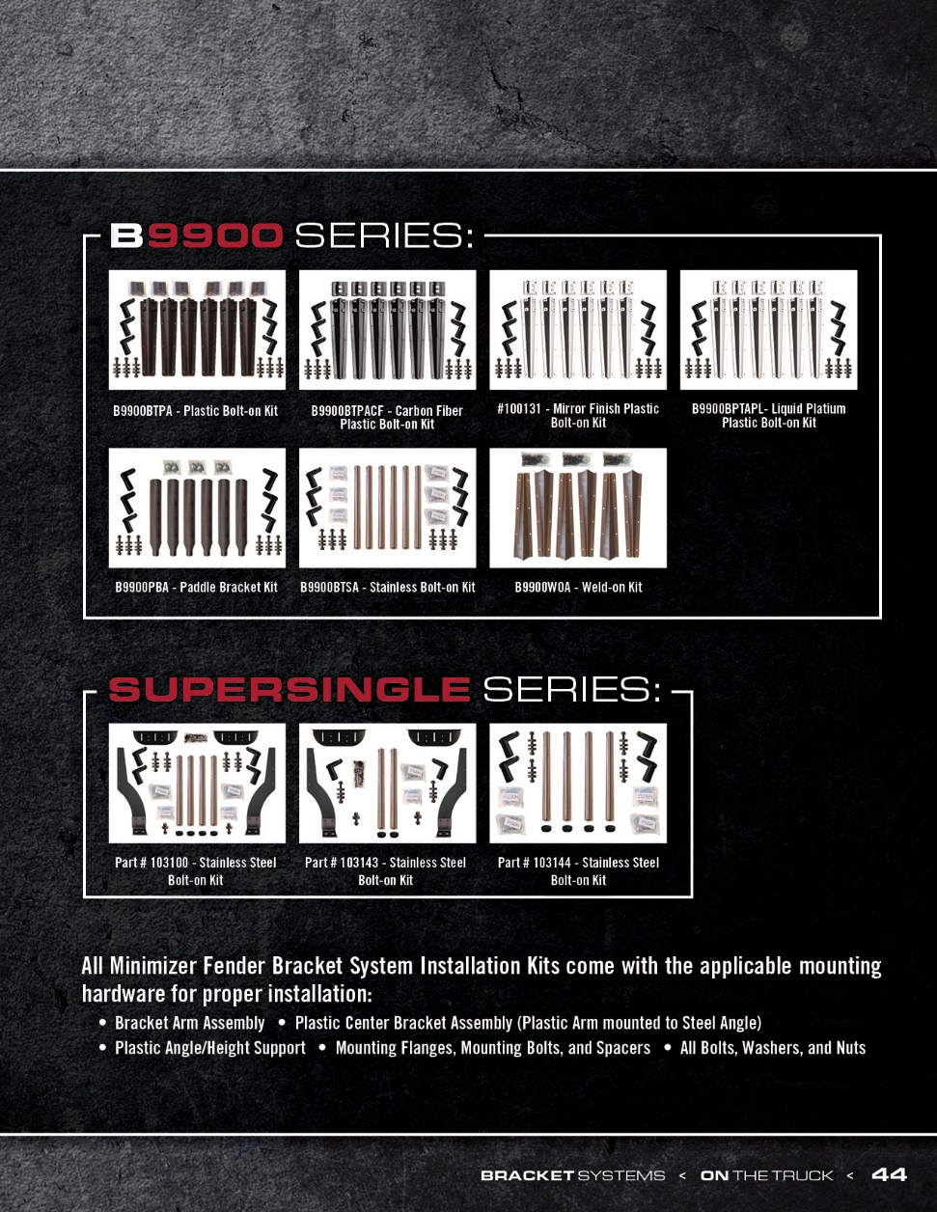
2021

Slide 24
2021

Slide 25
2021

Slide 26
2021

Slide 27
2021

Slide 28
2021

Slide 29
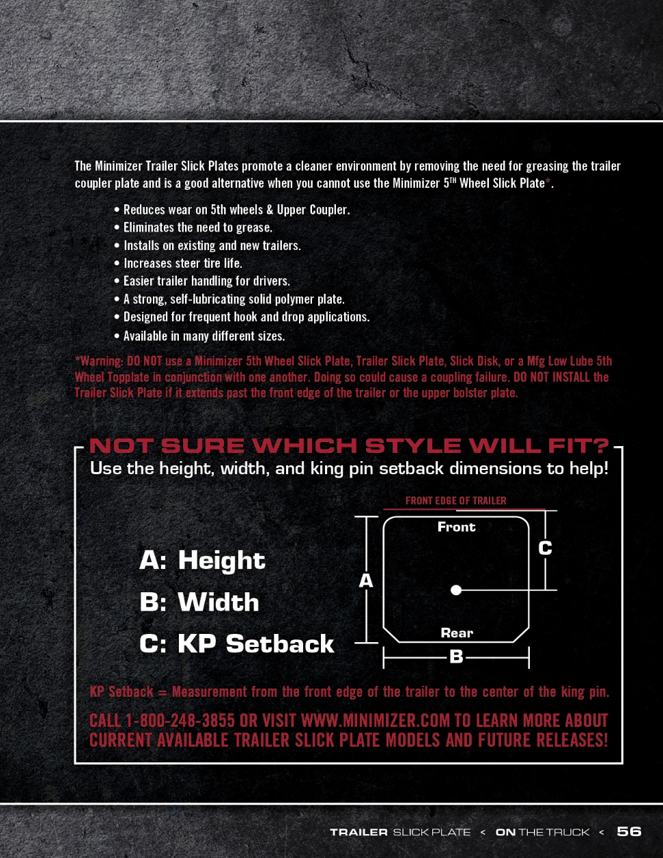
2021

Slide 30
2021

Slide 31
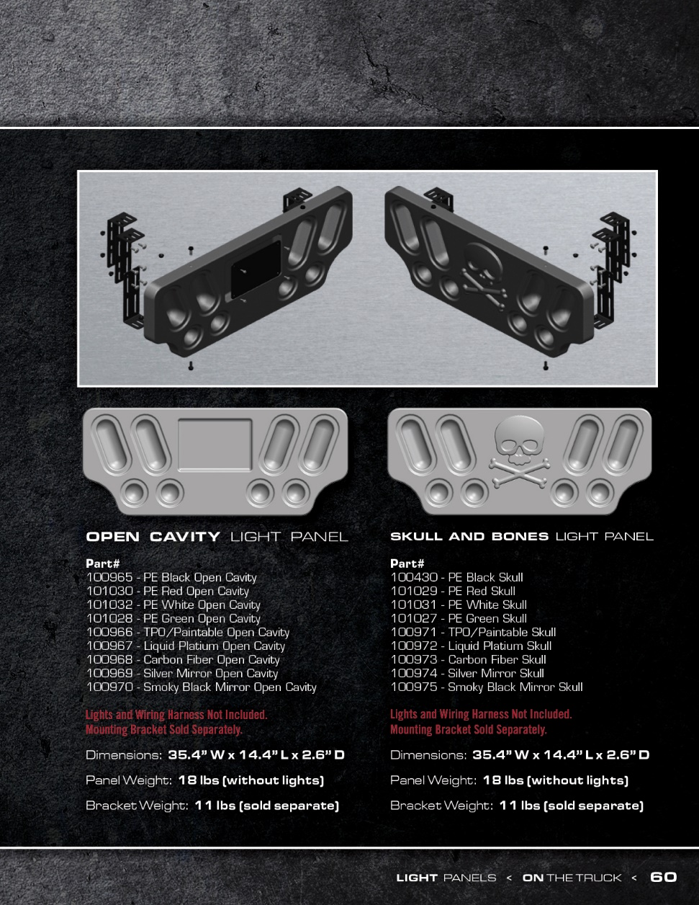
2021

Slide 32
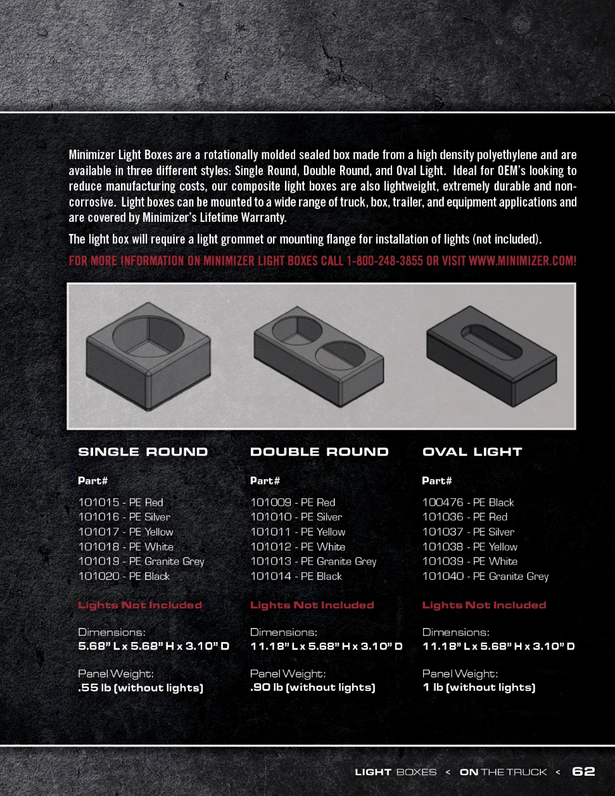
2021

Slide 33
2021

Slide 34
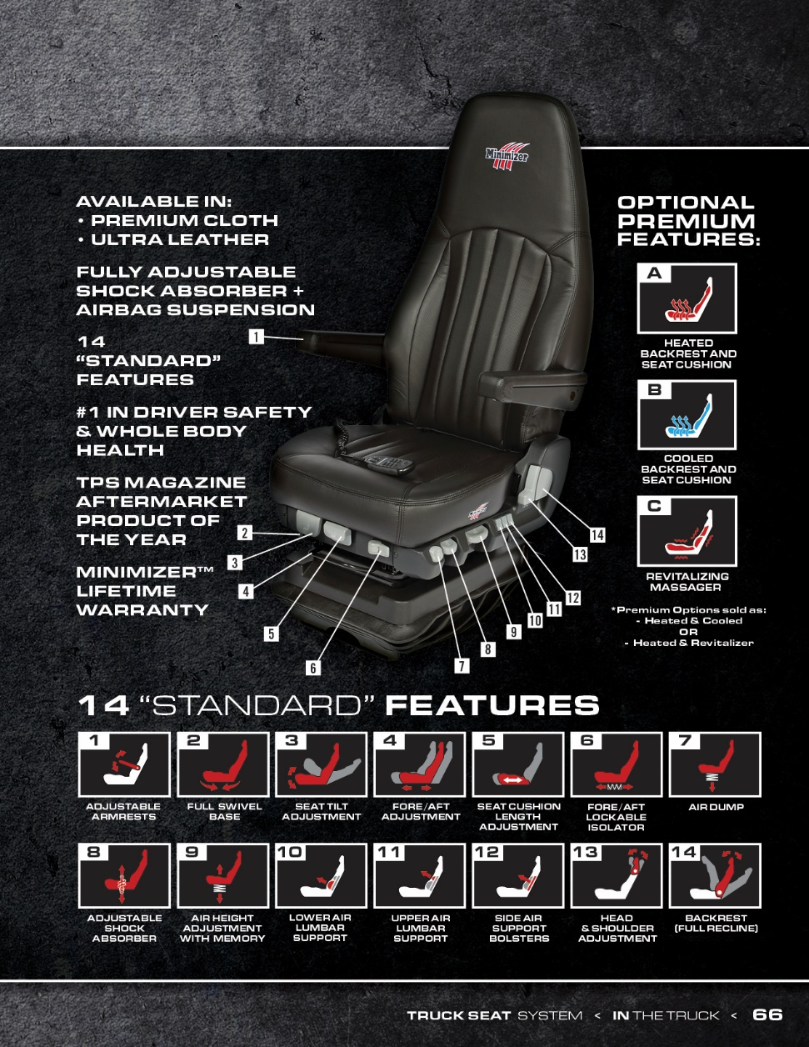
2021

Slide 35
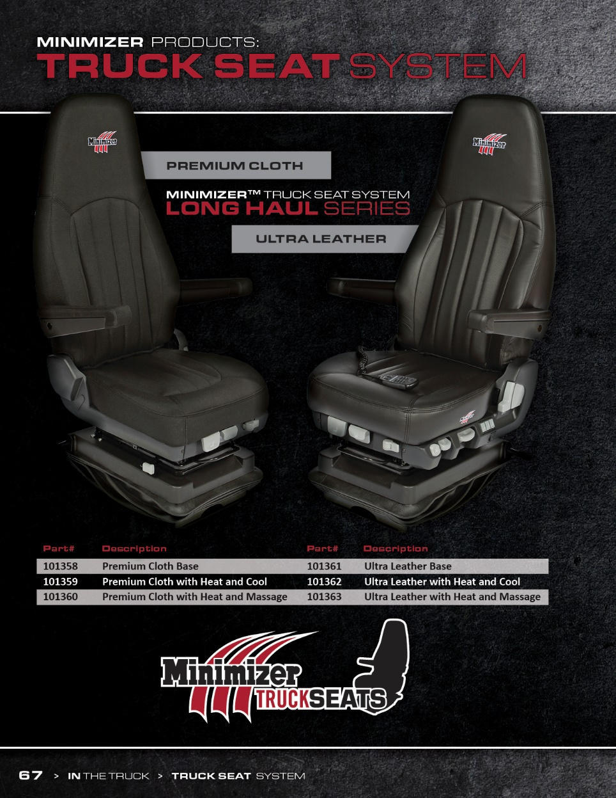
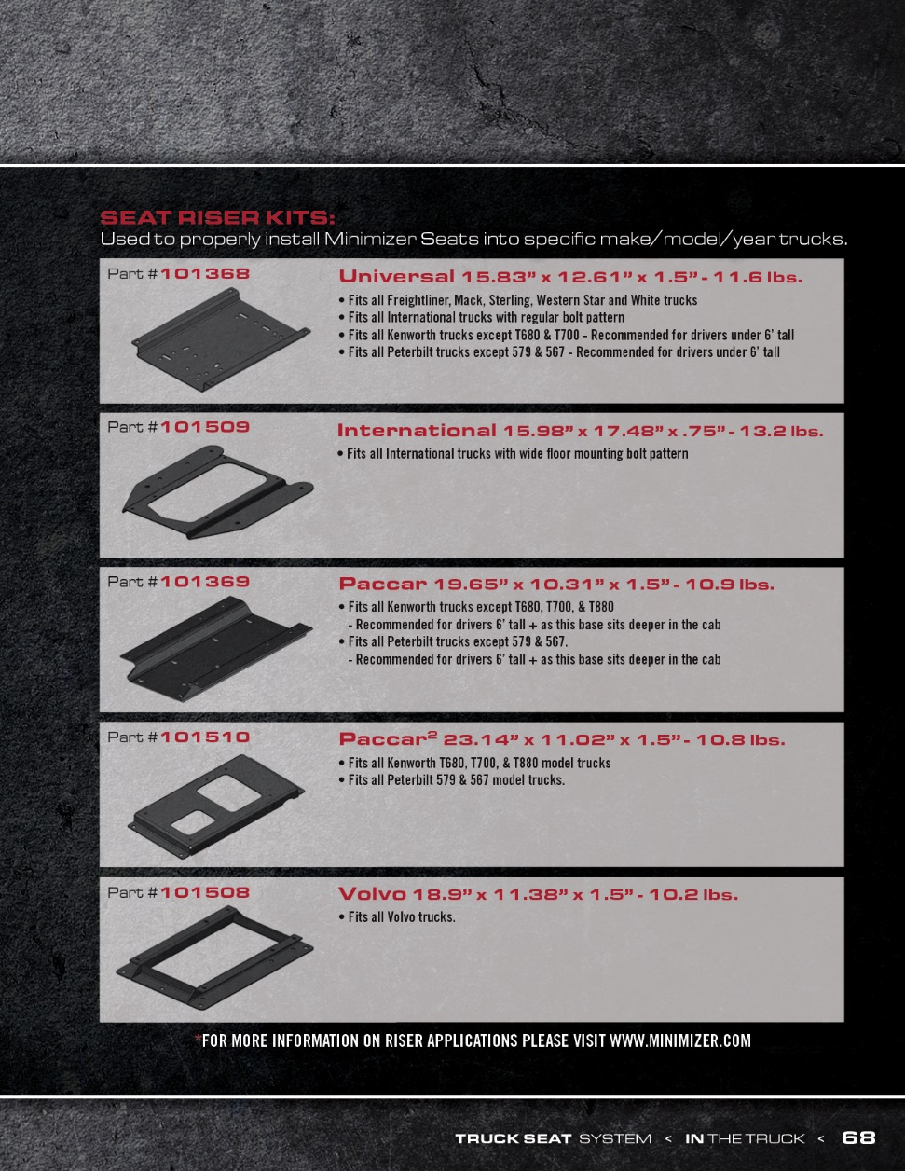
2021

Slide 36
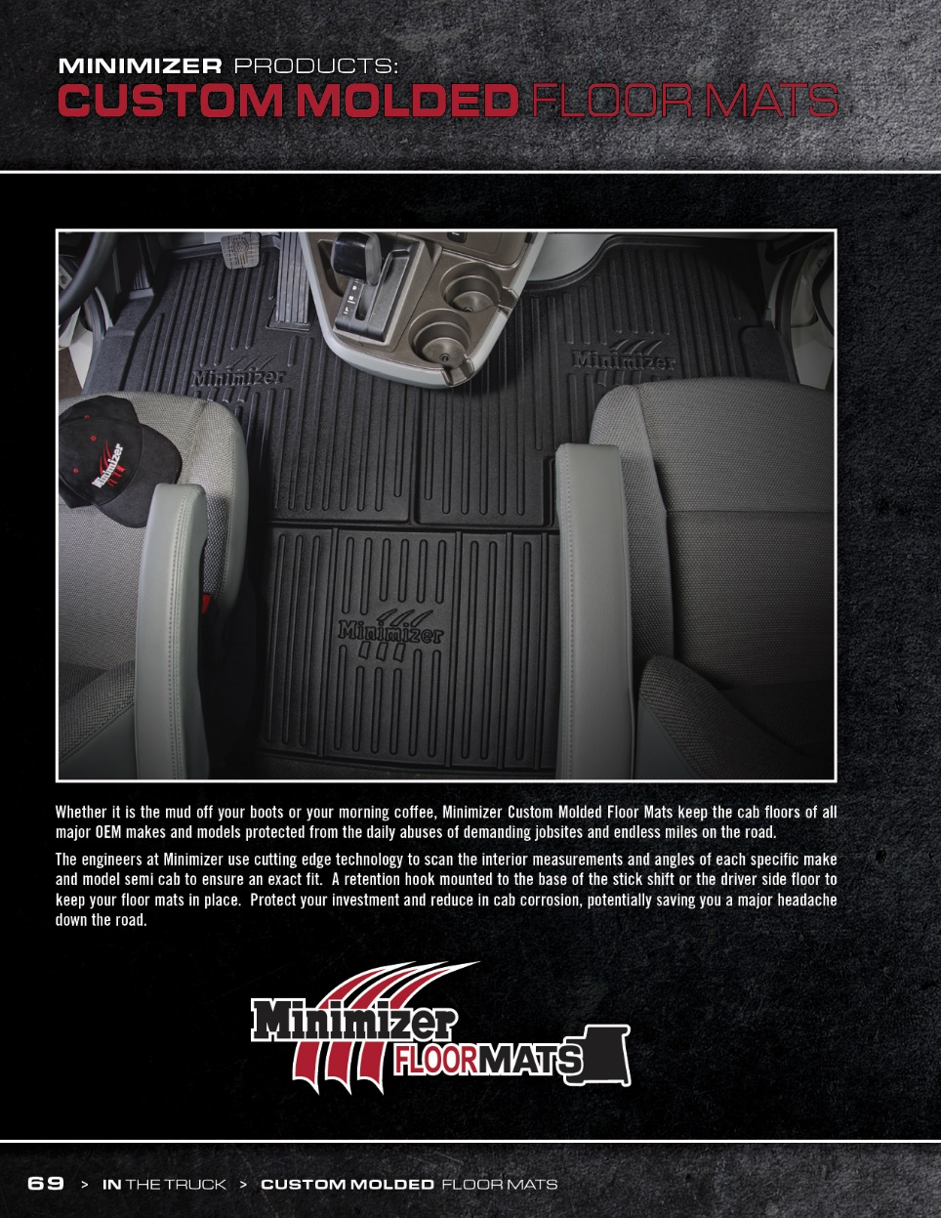
2021

Slide 37
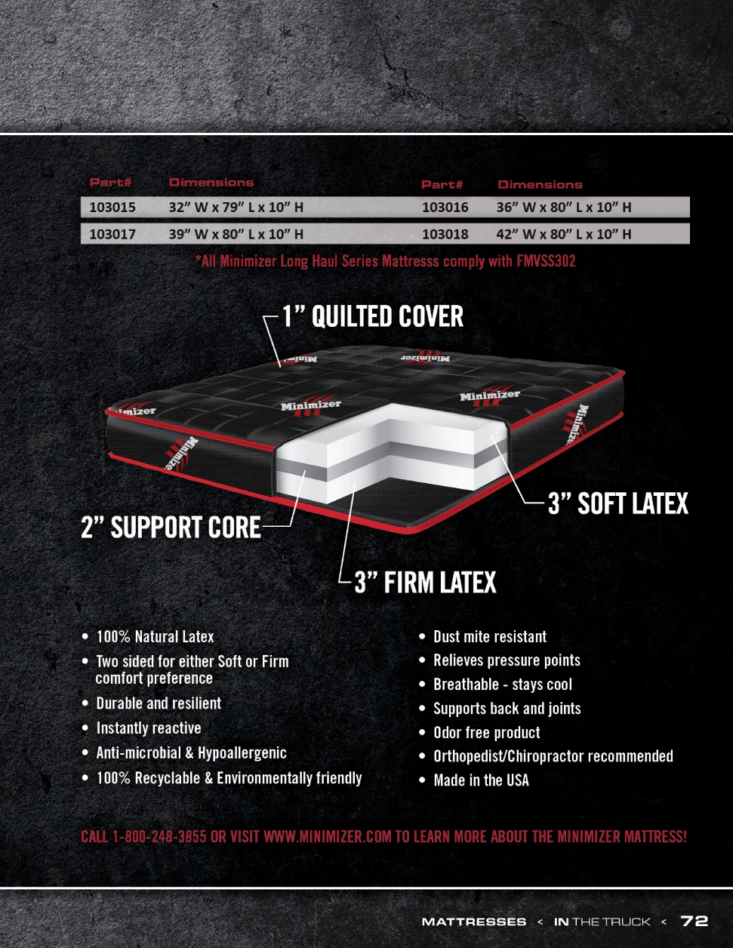
2021

Slide 38
2021

Slide 39
2021

Slide 40
2021

Slide 41
2021

Slide 42
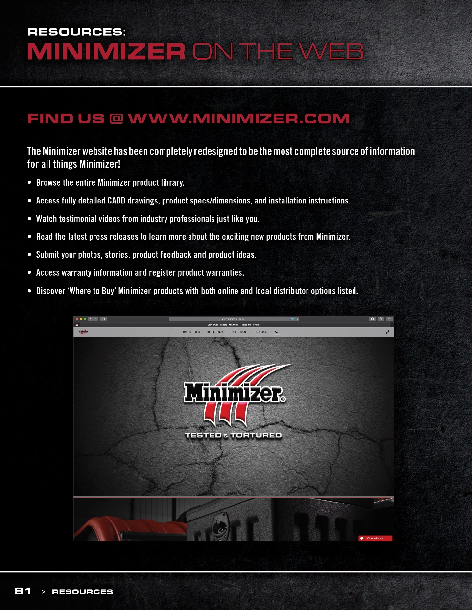
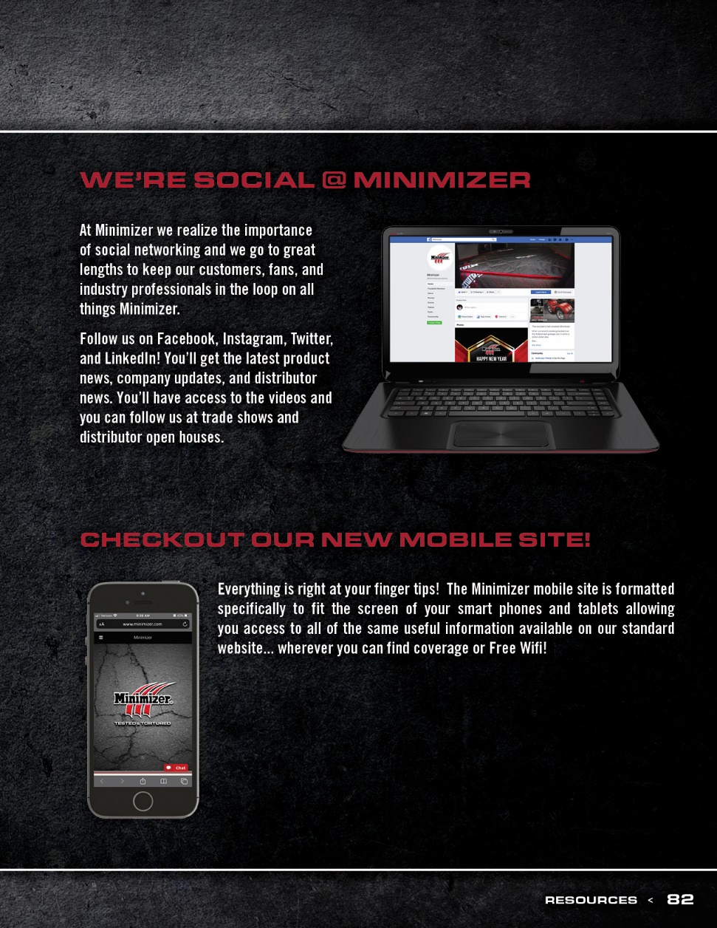
2021

Slide 43
Continue your Product Education with High Bar U!!
1 - Monthly 10 minute training video that is fun and informative
Automatically receive an (electronic) $5.00 gift card
55” TV giveaway each month
Also, 1 trip for 2 to Las Vegas drawn at the end of the year.
All expenses paid!!

Slide 44
High Bar U Overview Video

Slide 45
www.highbarbrands.com/resources

Slide 46
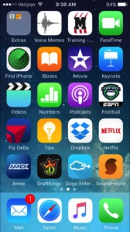
Order, download, or view updated literature
View or Download Minimizer Power Points
View all Minimizer Videos
Order POP Items
FAQ’s!!!!
Download all of our product photos and info
Floor mat selector
Facebook-ready posts
Setup a shortcut on your phone!!

Slide 47
Thank You!!

